Slide 1



IE 501 : Optimization Models
Improving profits for Supermarkets through shelf Optimization
Group Members : 24N0465, 24N0456, 24N0461, 24N0463
Supervised by :
Dr. Avinash Bhardwaj

Slide 2


Content
Motivation for the project | 1
Problem Statement | 2
Methodology | 3
Formulation | 4
Final Output | 5

Slide 3
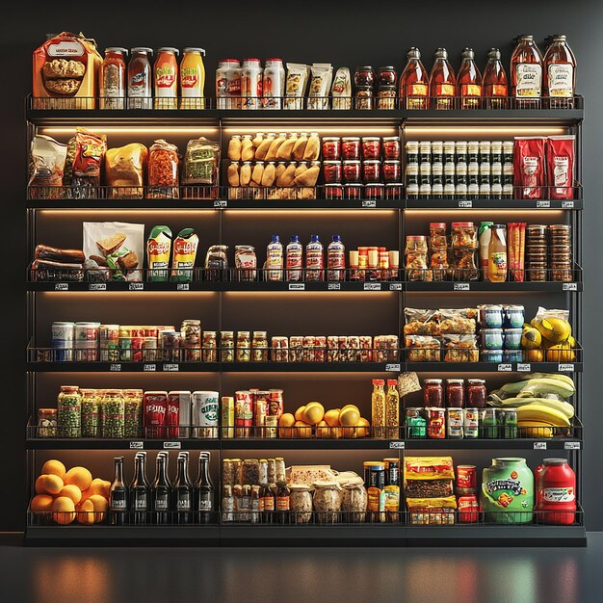
Motivation Behind the Project
Efficient shelf space allocation is vital for maximizing supermarket profitability. With limited shelf space and increasing customer demands, optimizing product placement ensures:
Maximizing Profits: Optimize shelf space for high-demand, high-margin products.
Customer Satisfaction: Ensure product availability and an enhanced shopping experience.
Cost Efficiency: Minimize restocking and inventory costs.
Complex Challenges: Address issues such as product fragility, and dependencies.
Scalable Solutions: Use data-driven optimization for real-world impact.

Slide 4

Problem Statement
Product Shelf Space Allocation and Optimization
The Problem focuses on allocating products to shelves in a retail store to maximize revenue while considering various parameters and constraints. These include shelf capacity, height, weight, visibility, and accessibility, as well as product-specific parameters such as revenue, space usage, fragility, turnover, and facings. The goal is to determine the optimal number of facings for each product on each shelf, while ensuring that shelf and product constraints are met.

Slide 5
Methodology
1
Data Simluation
Simulated product details (demand, size, fragility, profit margins).
Approach Overview
Formulated as a Mixed-Integer Linear Programming (MILP) model.
Objective: Maximize profitability while adhering to real-world constraints.
2
Model Formulation
Defined decision variables, constraints, and the objective function.
3
Optimization Technique
Solved using Pyomo/GLPK for efficient allocation.
4
Final output
Found optimized allocation of products to each shelves

Slide 6

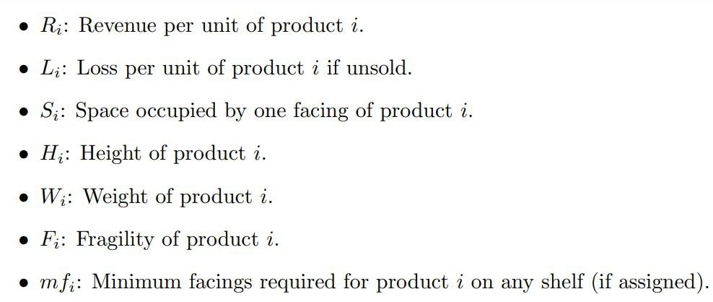
Formulation
1. Parameters

Slide 7
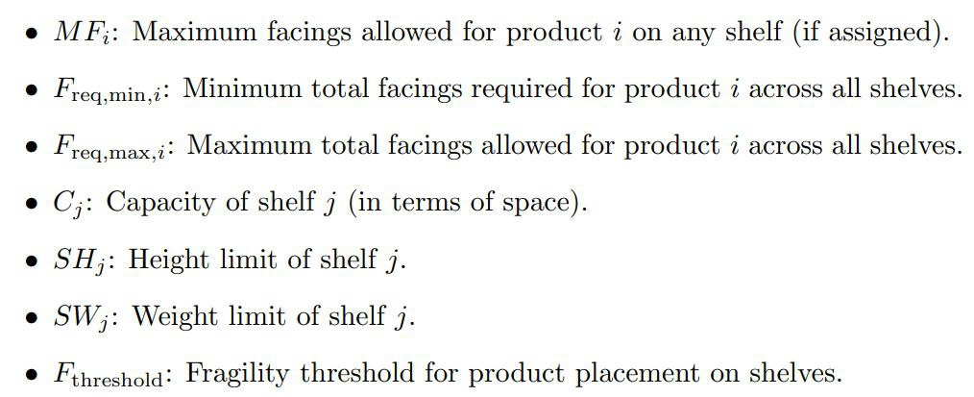
Formulation
1. Parameters

Slide 8
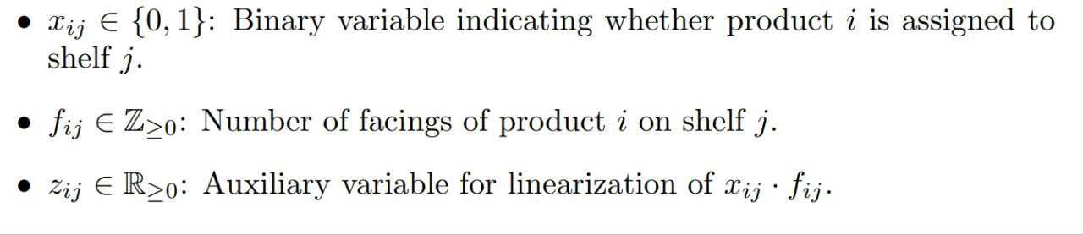
Formulation
2. Decision Variables

Slide 9
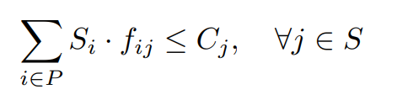

Formulation
3. Constraints
First constraint is for shelf space capacity and the second one is for fragility constraint

Slide 10
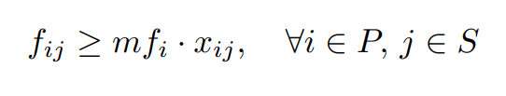

Formulation
3. Constraints
The first constraint ensures the lower bound on the number of facings for a product on a single shelf, while the second constraint establishes its upper bound.

Slide 11
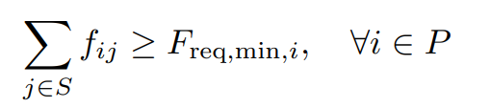
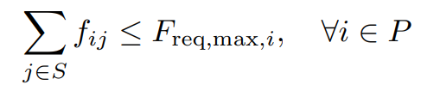
Formulation
3. Constraints
The first constraint ensures the lower bound on the number of facings for a product across all shelves, while the second constraint establishes its upper bound.

Slide 12
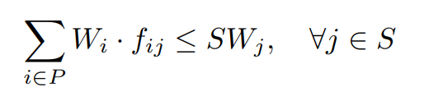
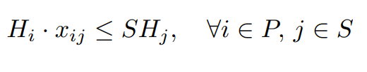
Formulation
3. Constraints
The first one is the Weight Constraint while the second one is the Height constraint.

Slide 13
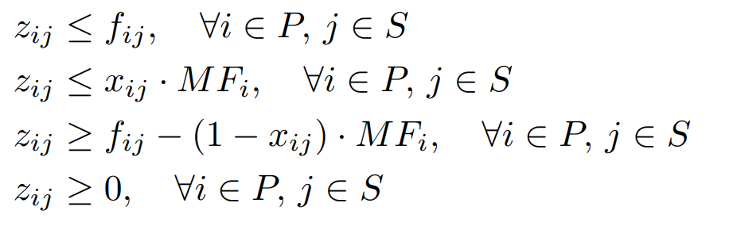
Formulation
3. Constraints
These are the linearization constraints which we need to ensure that the objective function remains linear and our model does not become non linear in nature.

Slide 14
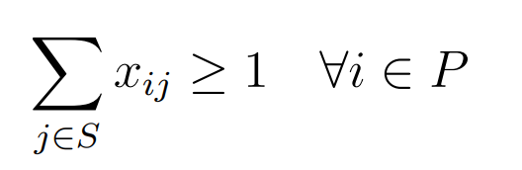
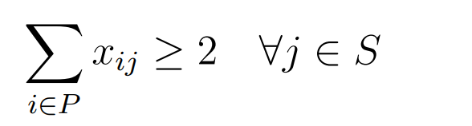
Formulation
3. Constraints
First one is product- shelf assignment constraint while the second one is diversity constraint

Slide 15
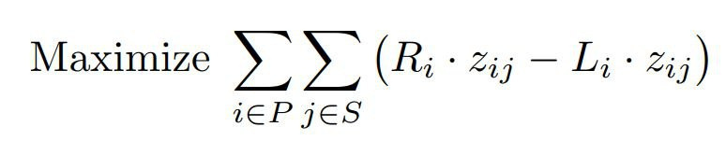
Formulation
4. Objective Function
Here Z_ij represents product of x_ij and f_ij, To maintain a linear formulation, the product was not directly included in the function.

Slide 16

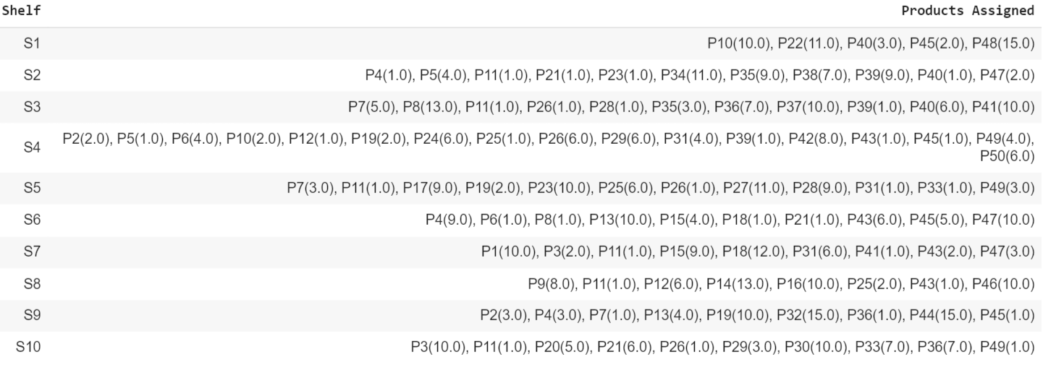
Final Output
After running our code, the output provides an optimized allocation, detailing which products and the exact quantities of each should be placed on each shelf.

Slide 17
Thanks

